Slide 1
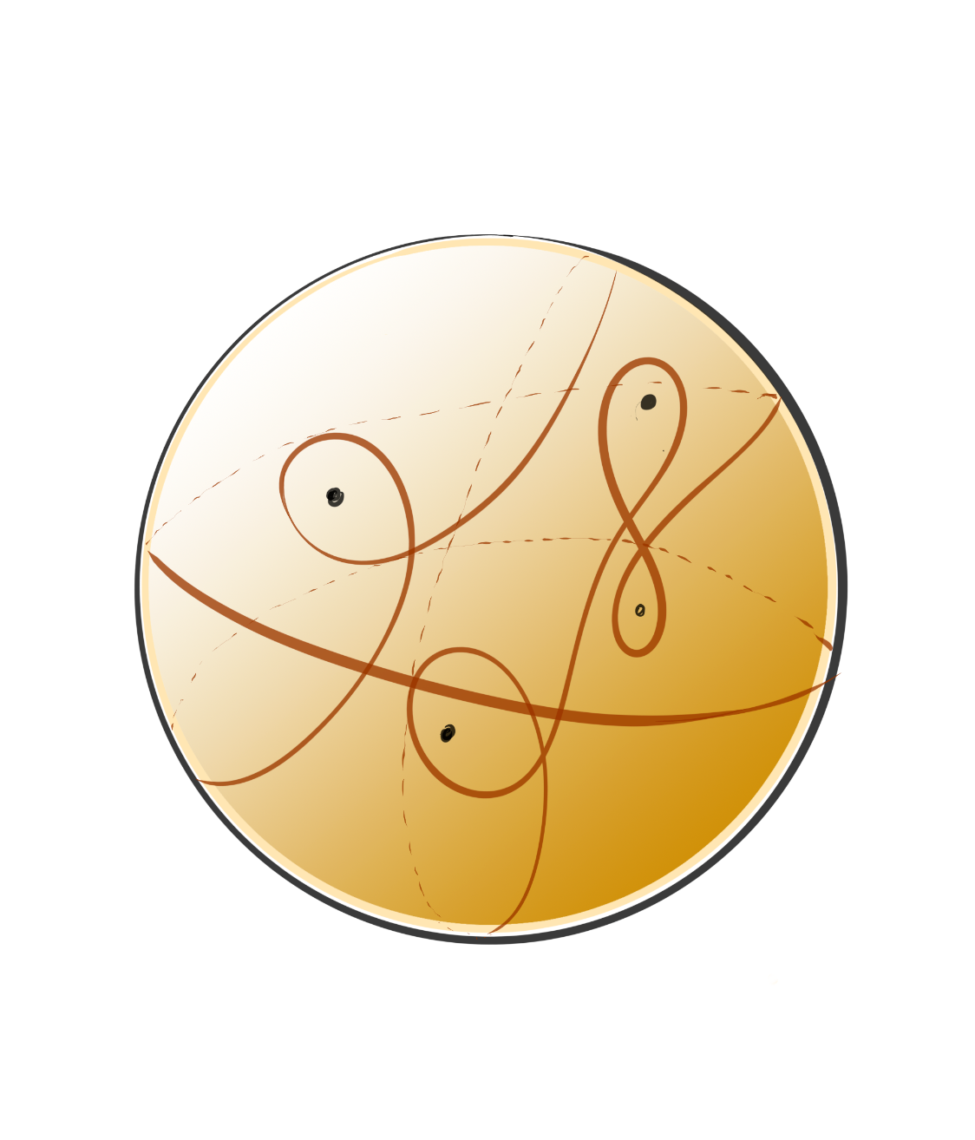
Distinguishing filling curve types via special metrics
Sayantika Mondal,
The Graduate Center, CUNY
(joint work with Ara Basmajian)
April 26, 2024
Arizona State University

Slide 2
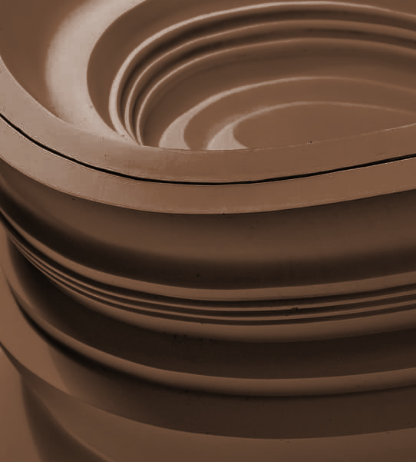
Table of contents
01
02
03
04
05
06
Setup
Constructing filling curves
Invariants
Relation between invariants
Computing Invariants
Results

Slide 3

01
Setup

Slide 4
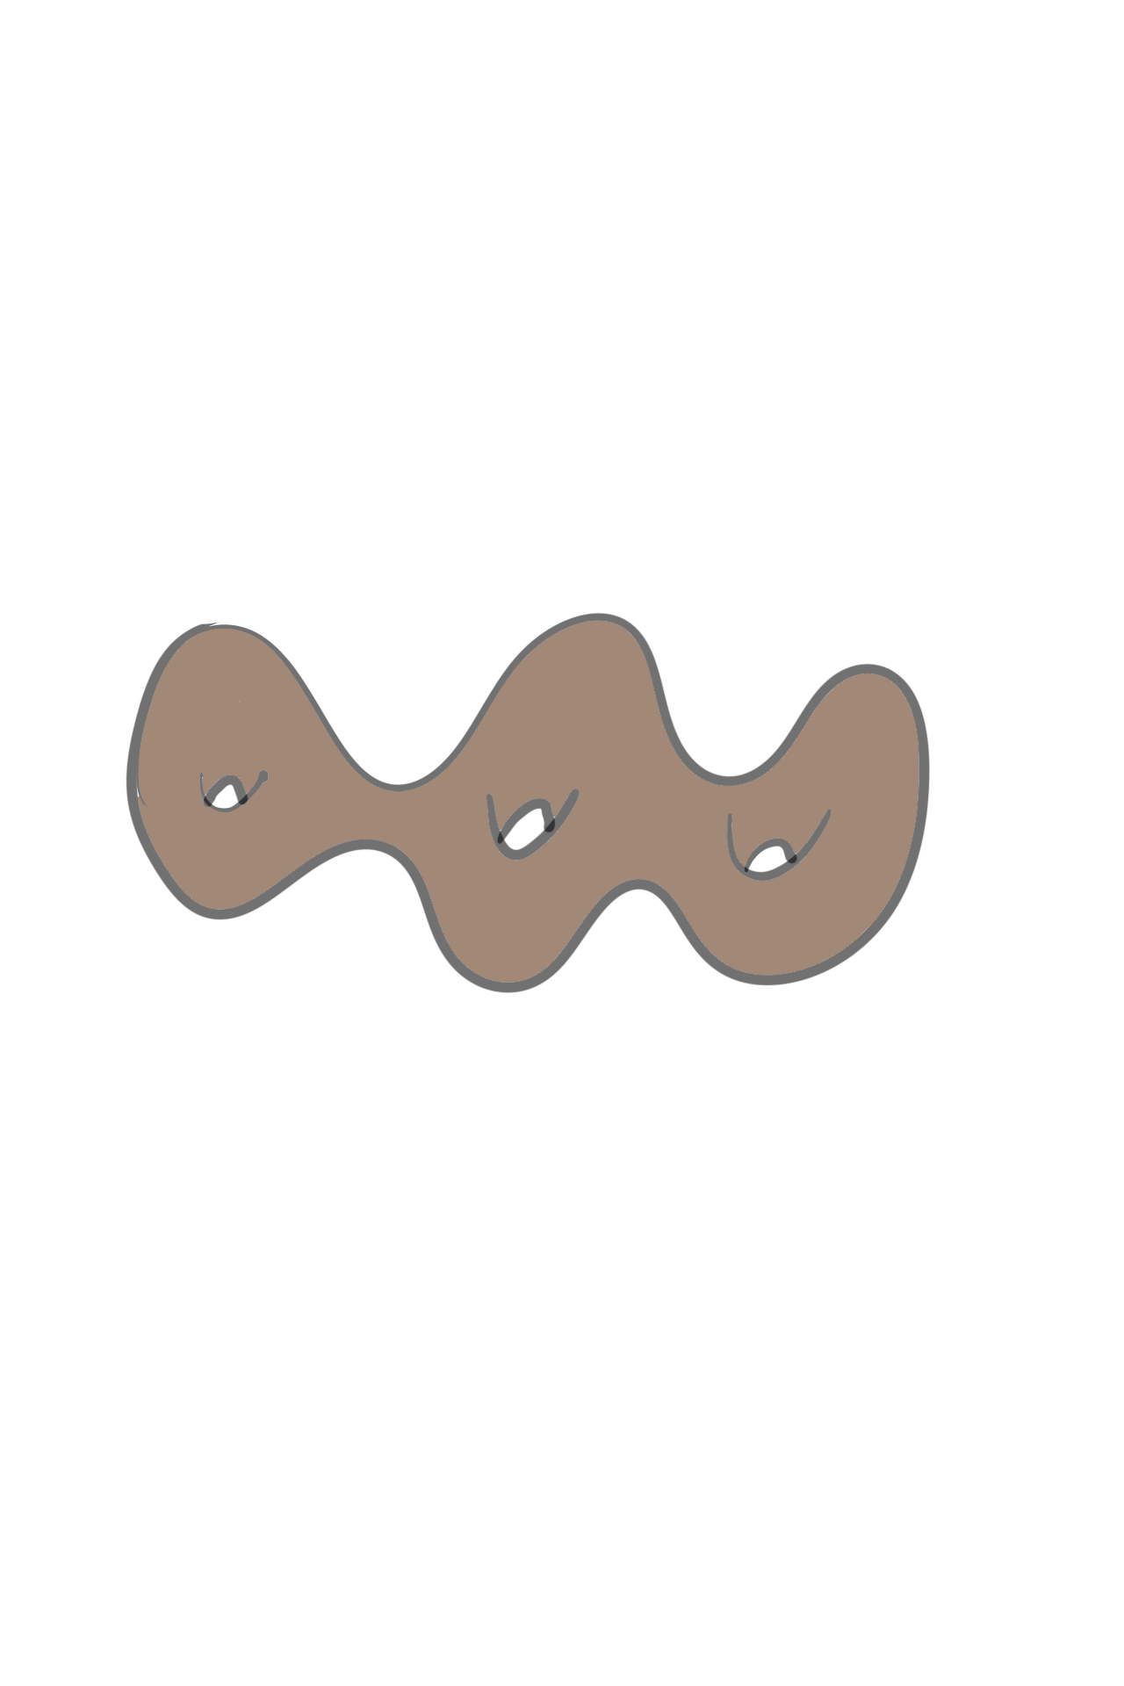
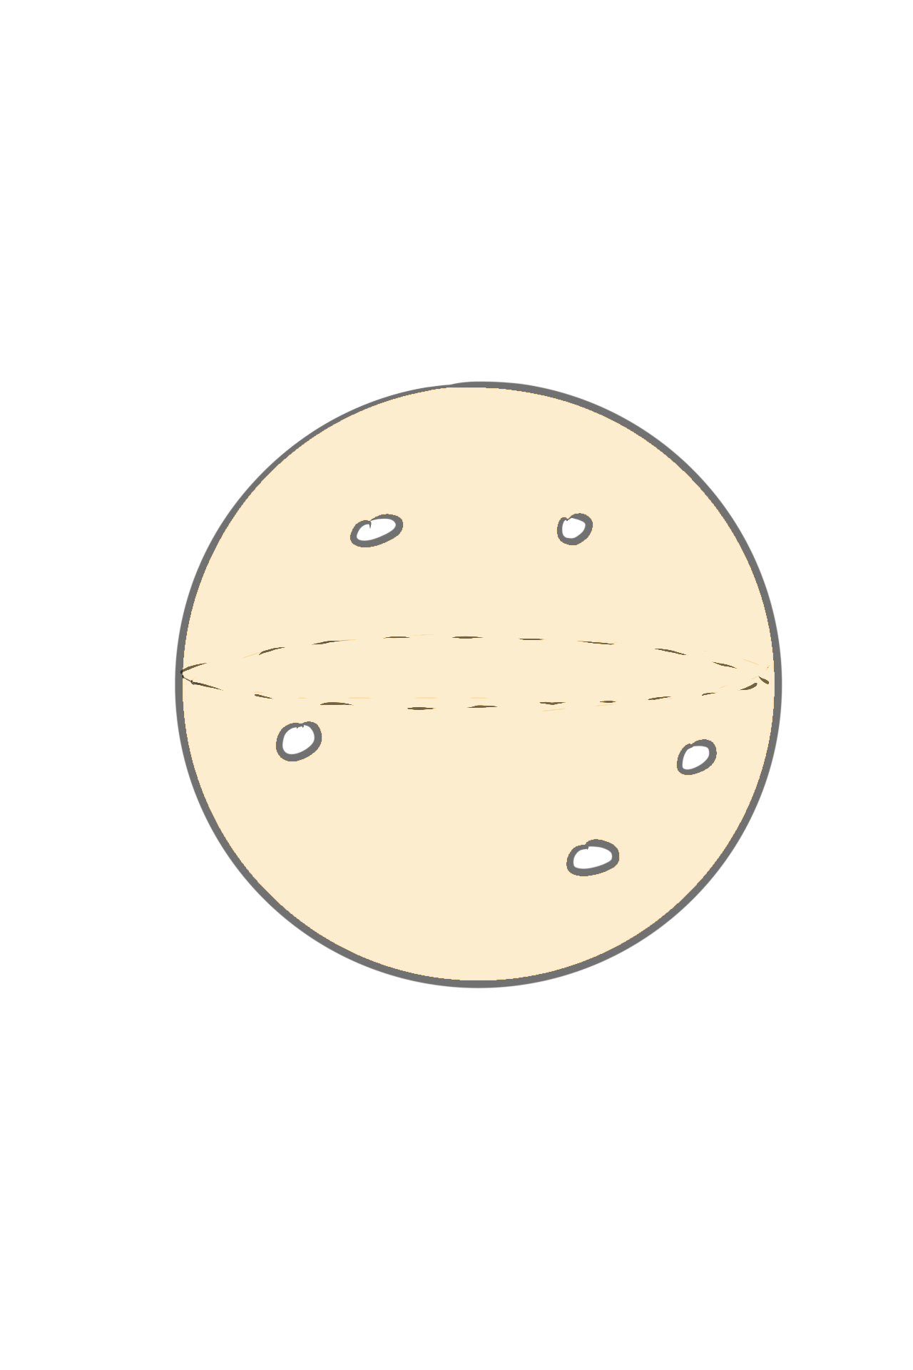
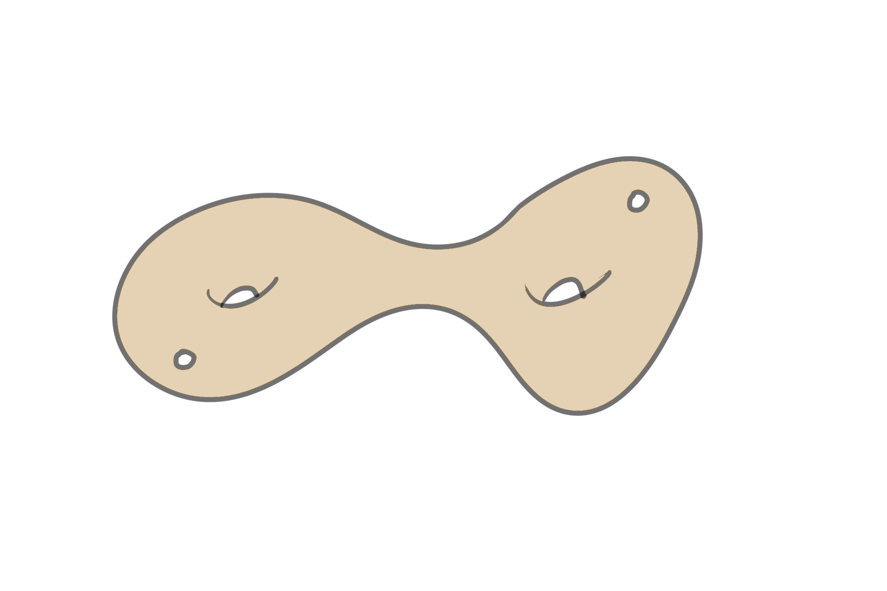
Surfaces
Finite type surfaces with negative Euler characteristic
(Topologically, genus g surfaces with n points removed)
Sphere with 3 or more punctures
Closed surfaces genus >1
Surface g surface with n boundary (g , n > 0)

Slide 5
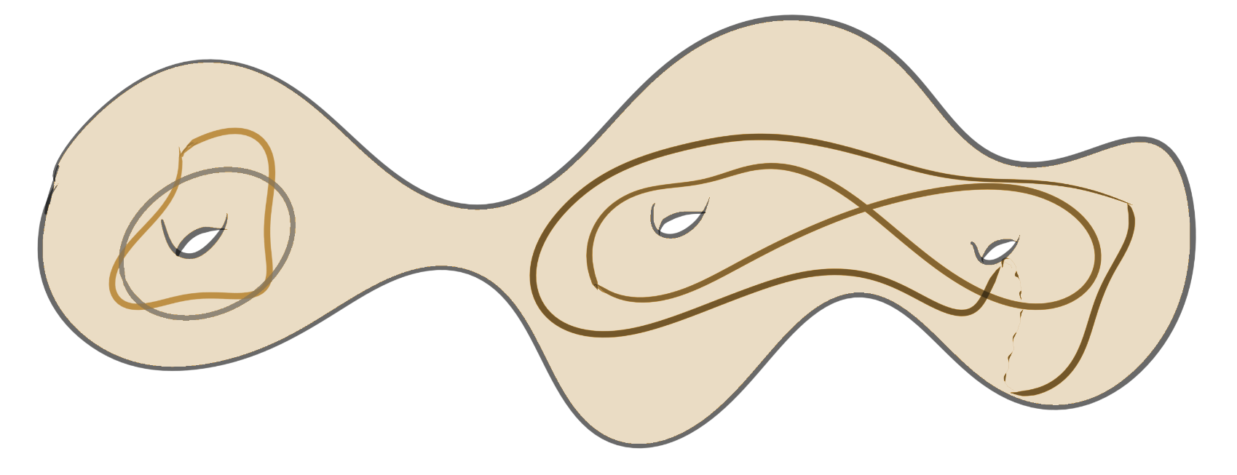
Curves
We will consider all curves up to homotopy class
Closed curves
Primitive (not powers of other curve)
Essential (not homotopic to a boundary)
In each homotopy class there is a unique geodesic (shortest one)
Curves are “nice”

Slide 6
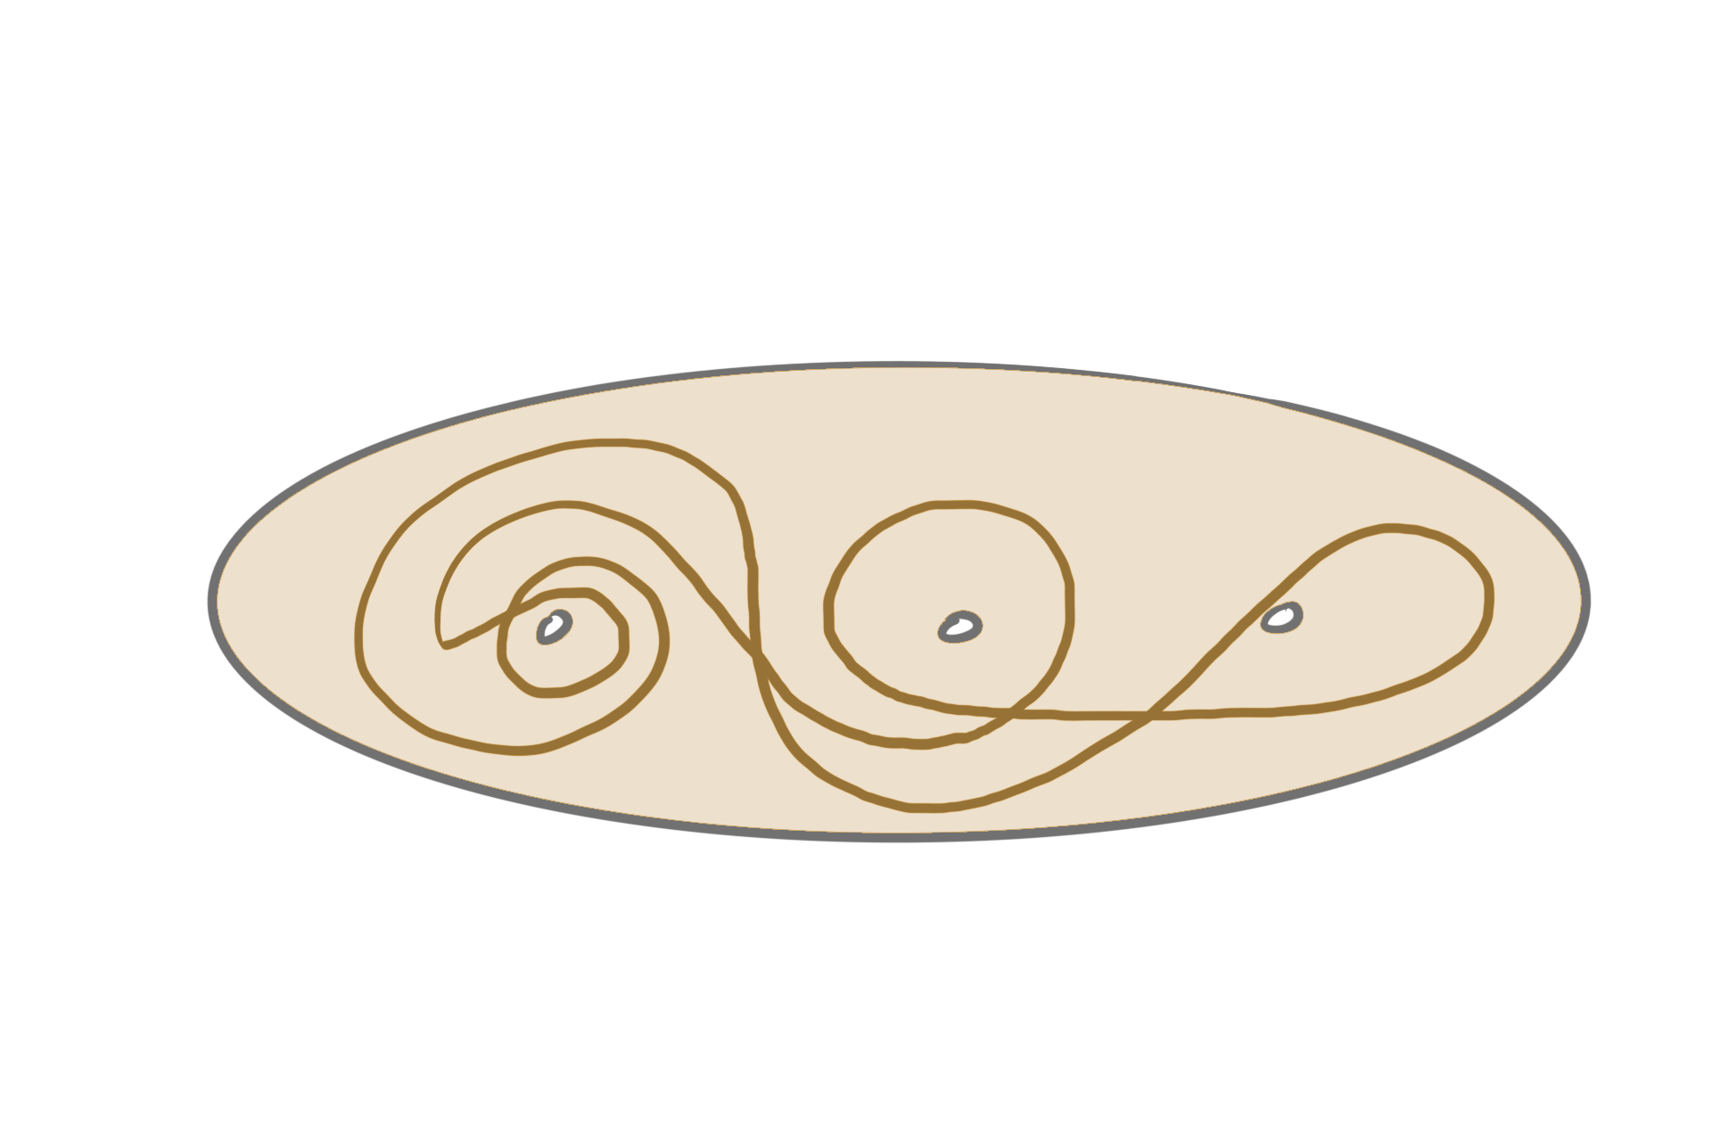
Filling Curves:
Example:
Definition:
A closed curve on a surface is said to be filling if it intersects every essential simple, non-peripheral closed curve on the surface.
Complement of a filling curve is a union of discs and annuli
Alternative
Definition:

Slide 7
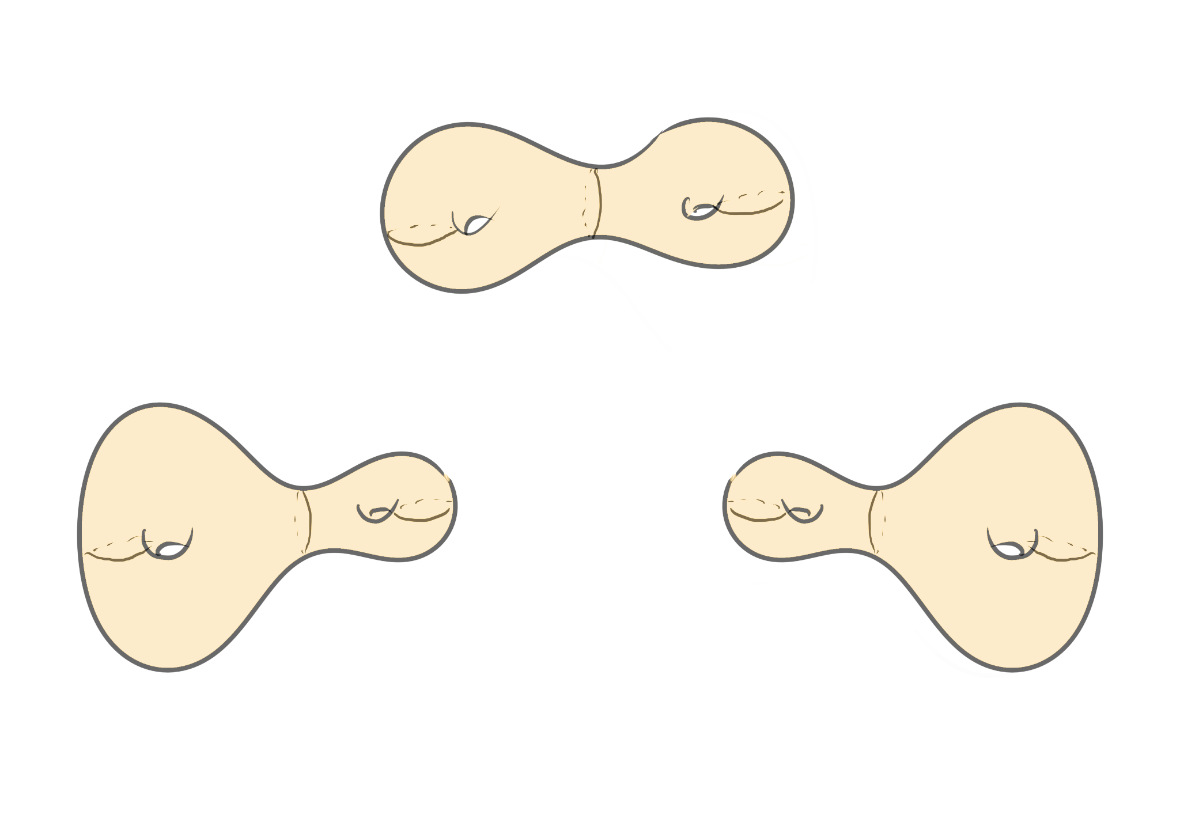
Teichmüller Space
Set of isotopy classes of marked hyperbolic structures.
Each point in Teichmüller space of 𝜮, can be denoted as (X,f ) where X is a surface with complete, finite area hyperbolic structure with geodesic boundary and f is a diffeomorphism from 𝜮 to X.
(X, f) ~ (Y, g) if f o g ⁻¹ is isotopic to an isometry.
3 different points in Teichmüller space

Slide 8
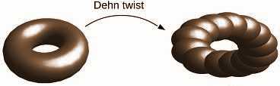
Mapping Class Group
Group of orientation preserving isometries up to isotopy
MCG := Diffeo ⁺ (𝜮) / ~
f ~ g if f o g ⁻¹ is isotopic to identity
Easy example: Dehn twists
The MCG acts naturally on the Teichmüller space.
g o (X,f) (X, f o g ⁻¹ )
Acts by “unmarking”

Slide 9
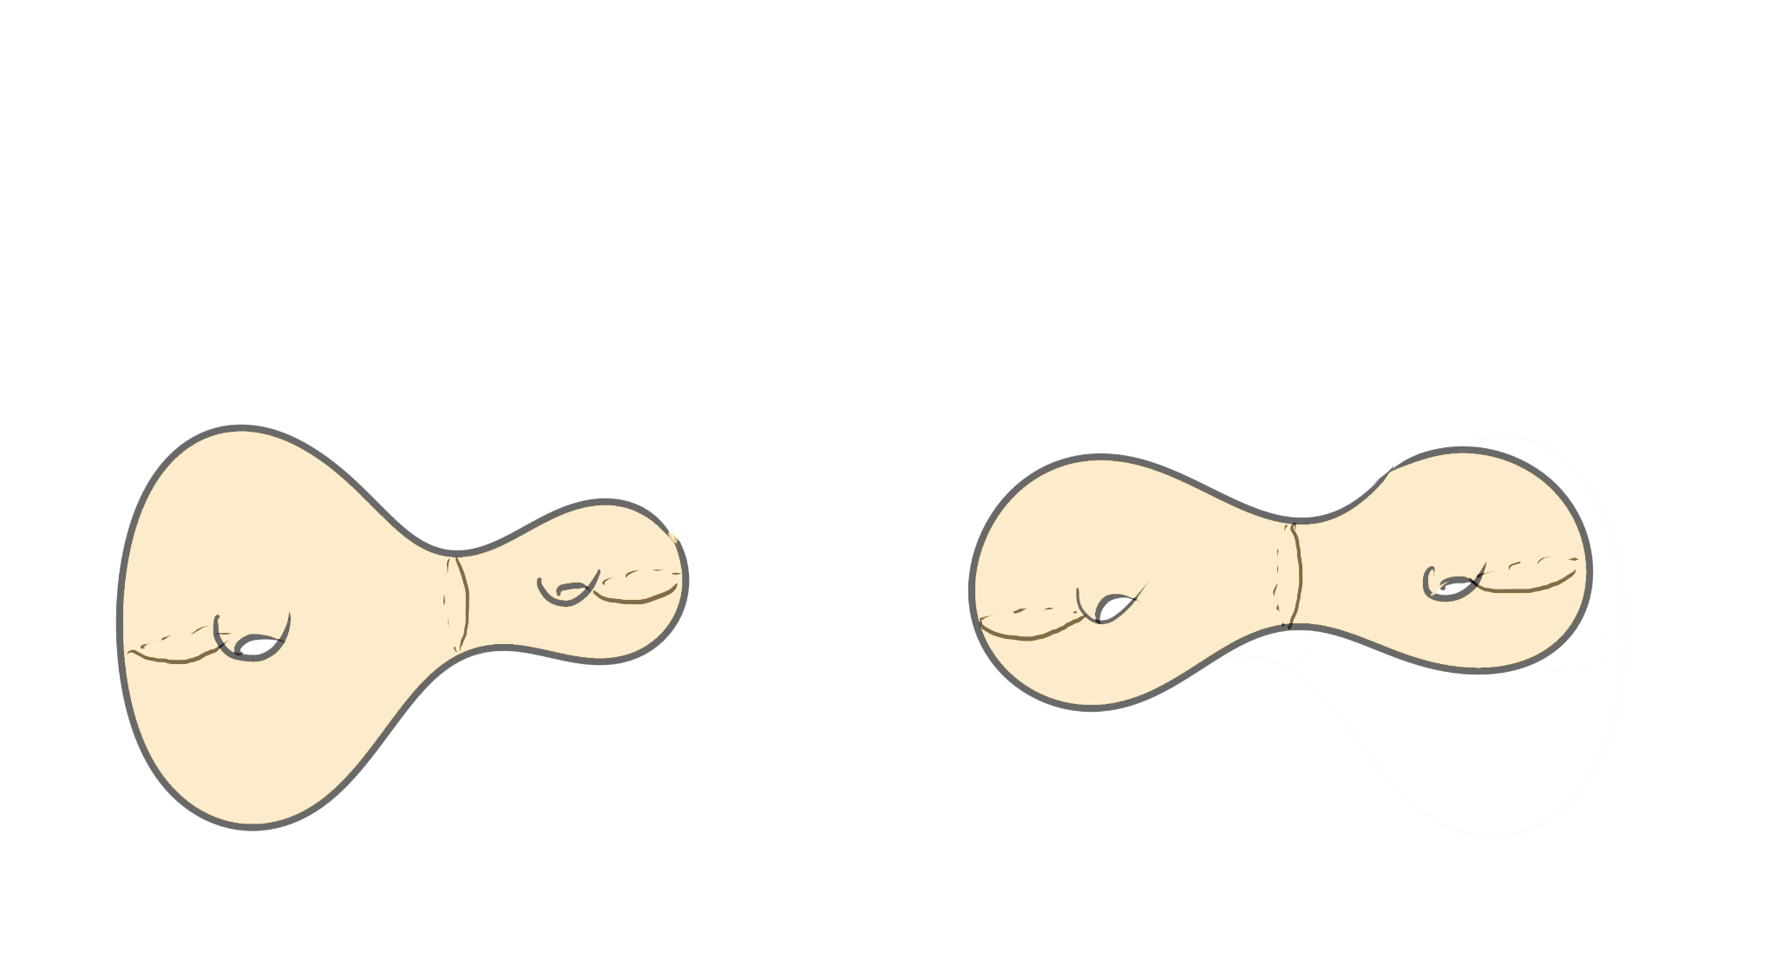
Moduli Space
Moduli space Mg is the quotient of Teichmüller space under the action of MCG.
Two points (X, f) and (X, g) that map to the same point in moduli space differ by the action of the mapping class g⁻¹ ◦ f
3 different points in Teichmüller space
2 different points in Moduli space

Slide 10
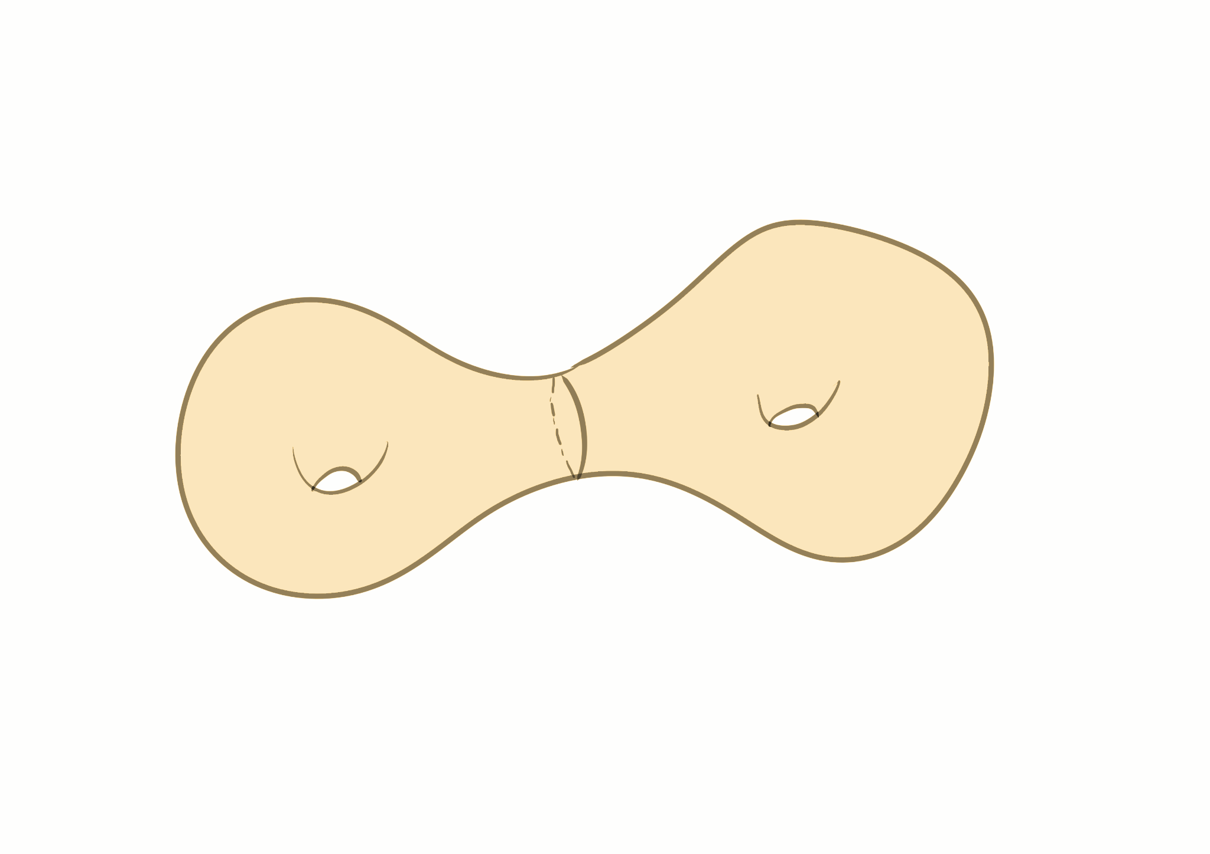
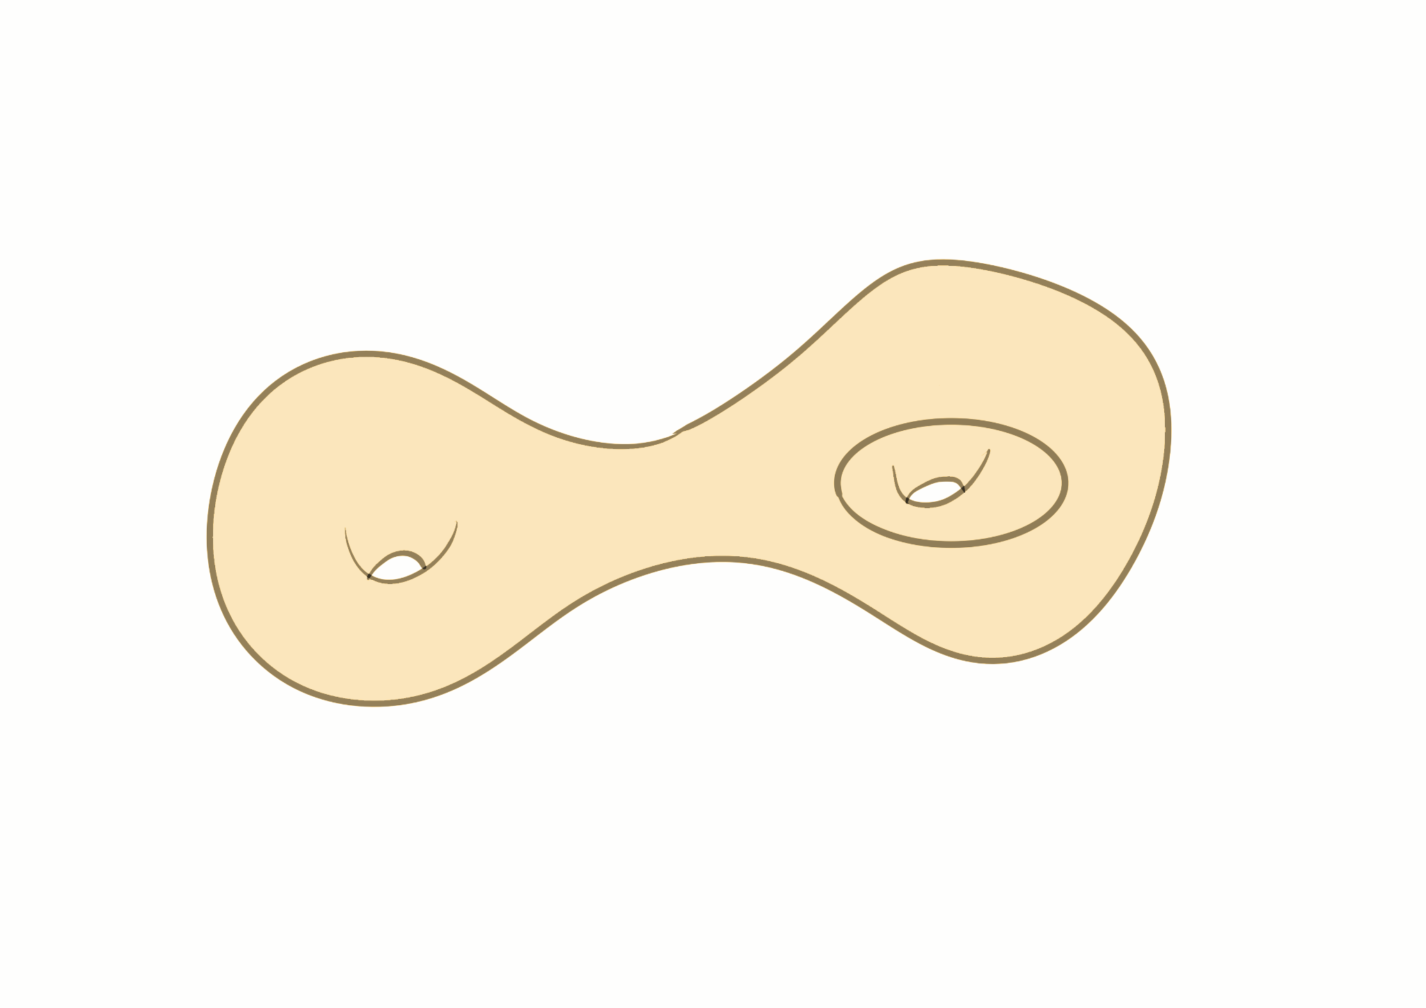
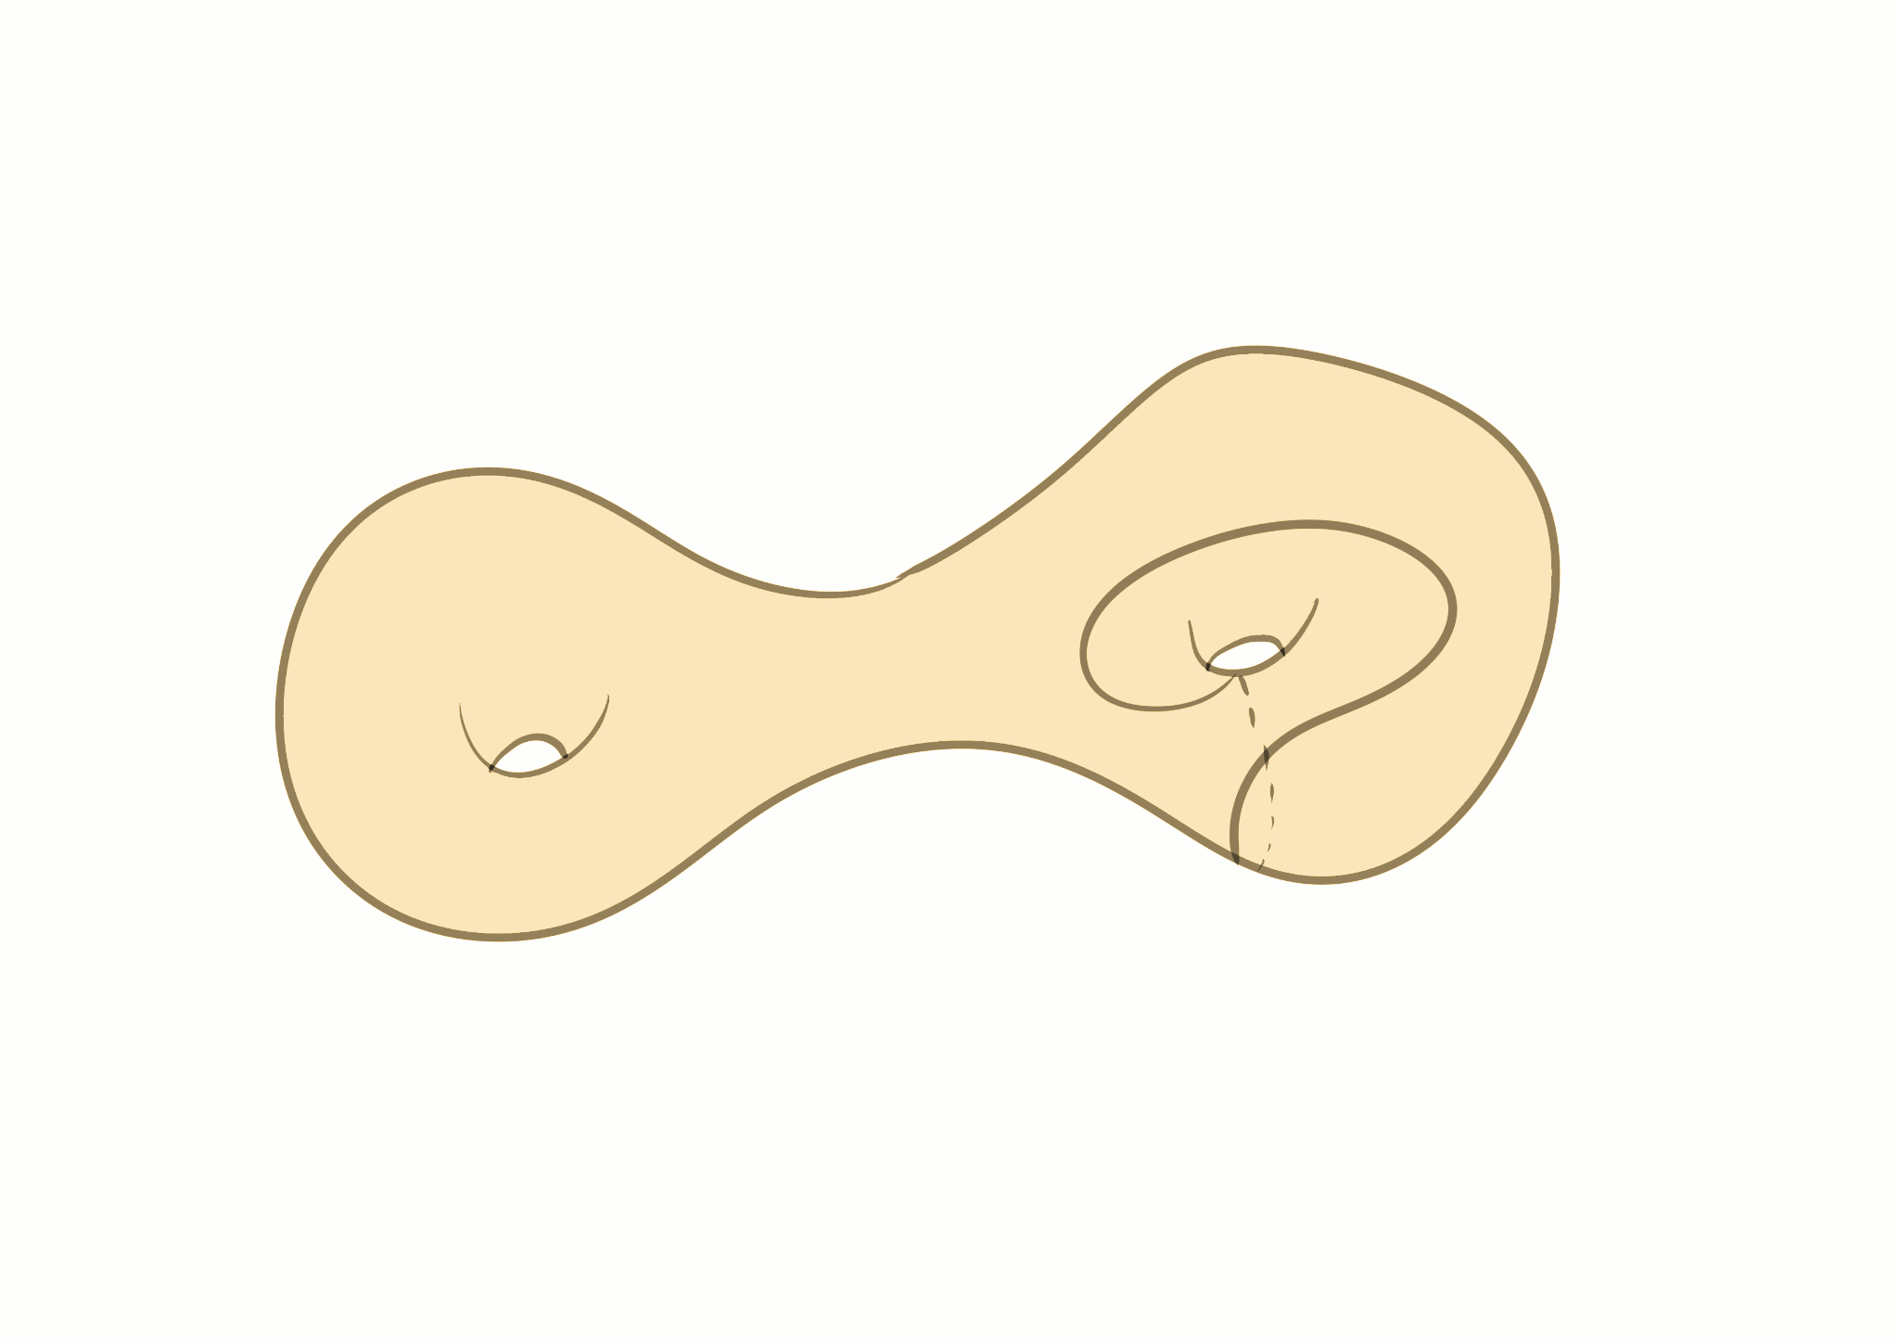
Topological Types
Two curves are said to be of the same topological type if there is a mapping class group element taking one to the other.
Different
Same

Slide 11

02
Constructing Filling curves

Slide 12
Minimal filling curve
Definition:
Filling curve with the minimum self intersection number on a given surface.
For a closed surface of genus g, this curve is unique and has intersection number 2g - 1. (C. Arettines , 2015).
The complement is exactly one disk!
We extend this construction to surfaces with boundaries (genus g and n boundary components).
Intersection number = 2g − 1 + max {0 , (n − 1)}
Complement consists of annuli.

Slide 13
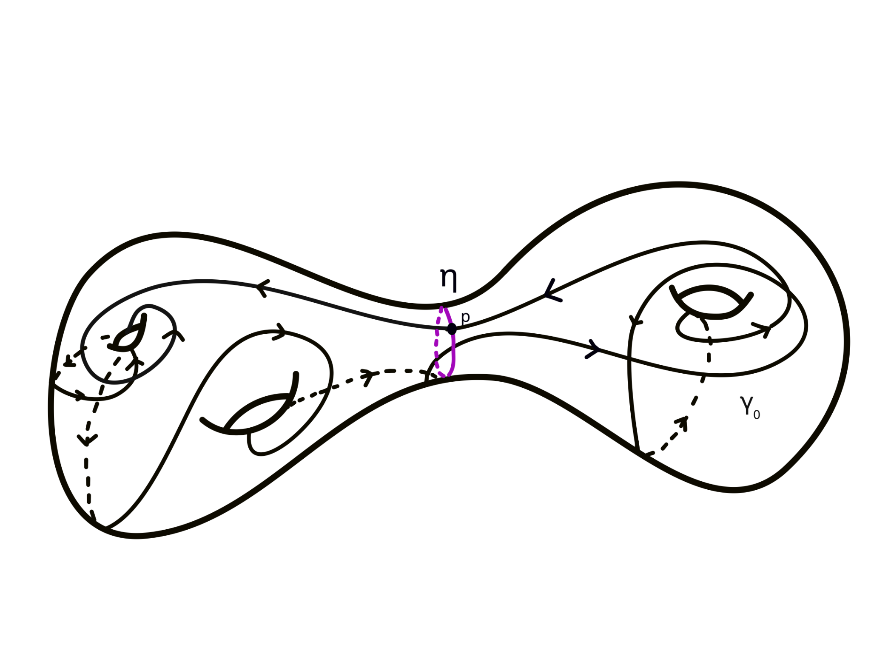

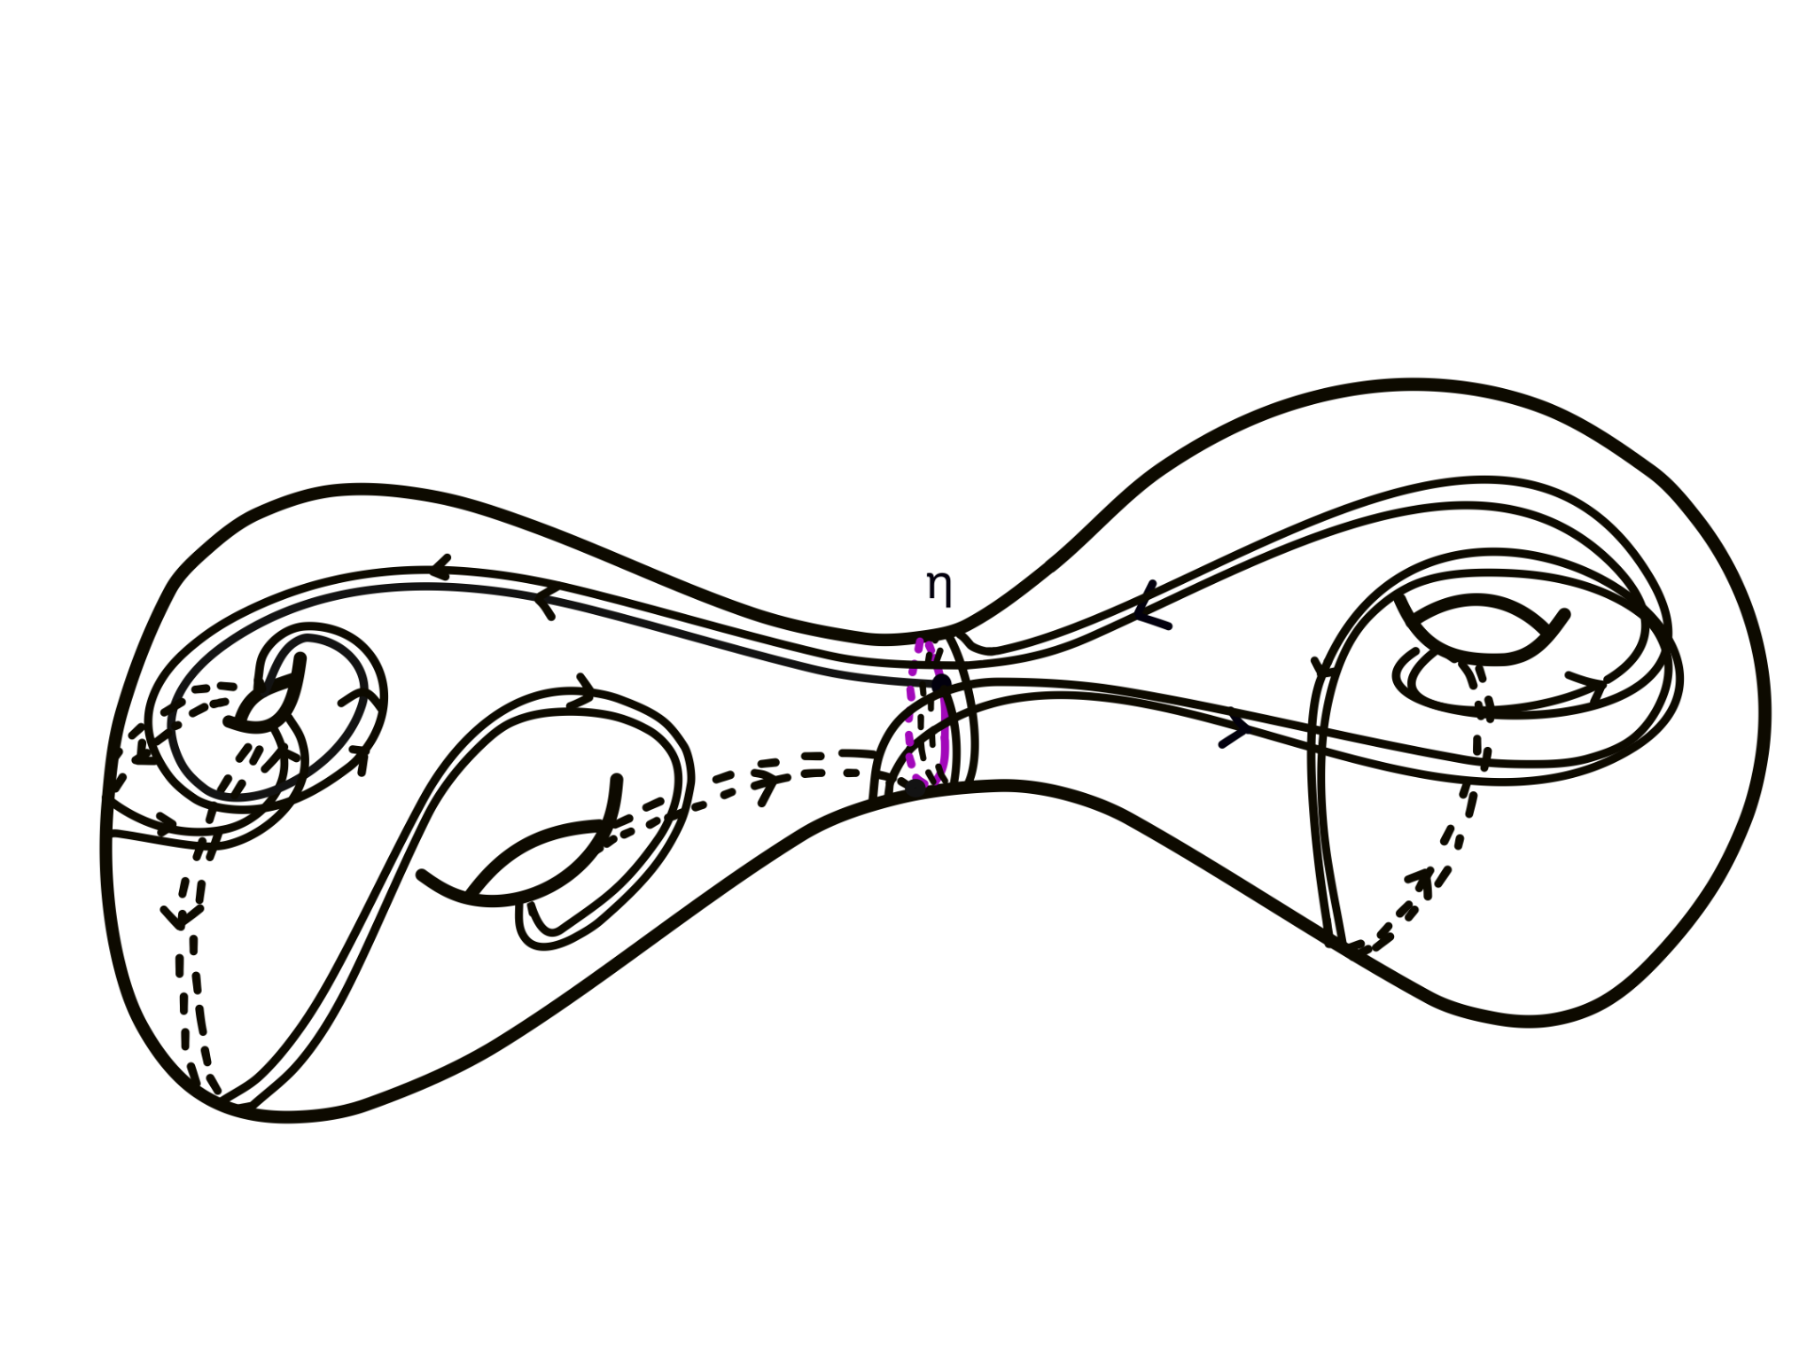
Family 1: Separating Curve Case
Start with a (minimal) filling curve γ₀
Cut at an intersection point with a separating curve.
Given a pair of positive
integers (m, n) , let γ be the curve η^{m} ∗ γ₀^{n}
(based at the intersection point)
A (2,2) curve

Slide 14
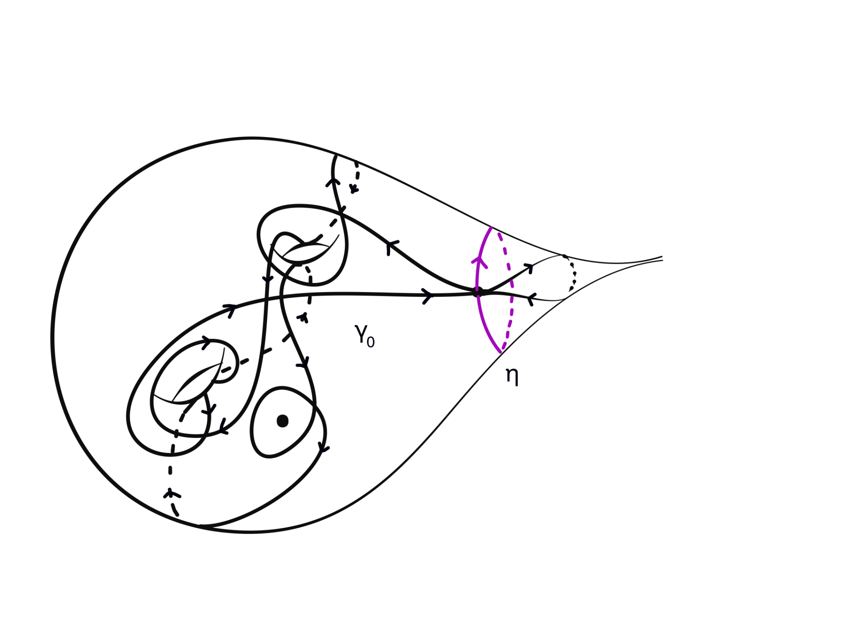
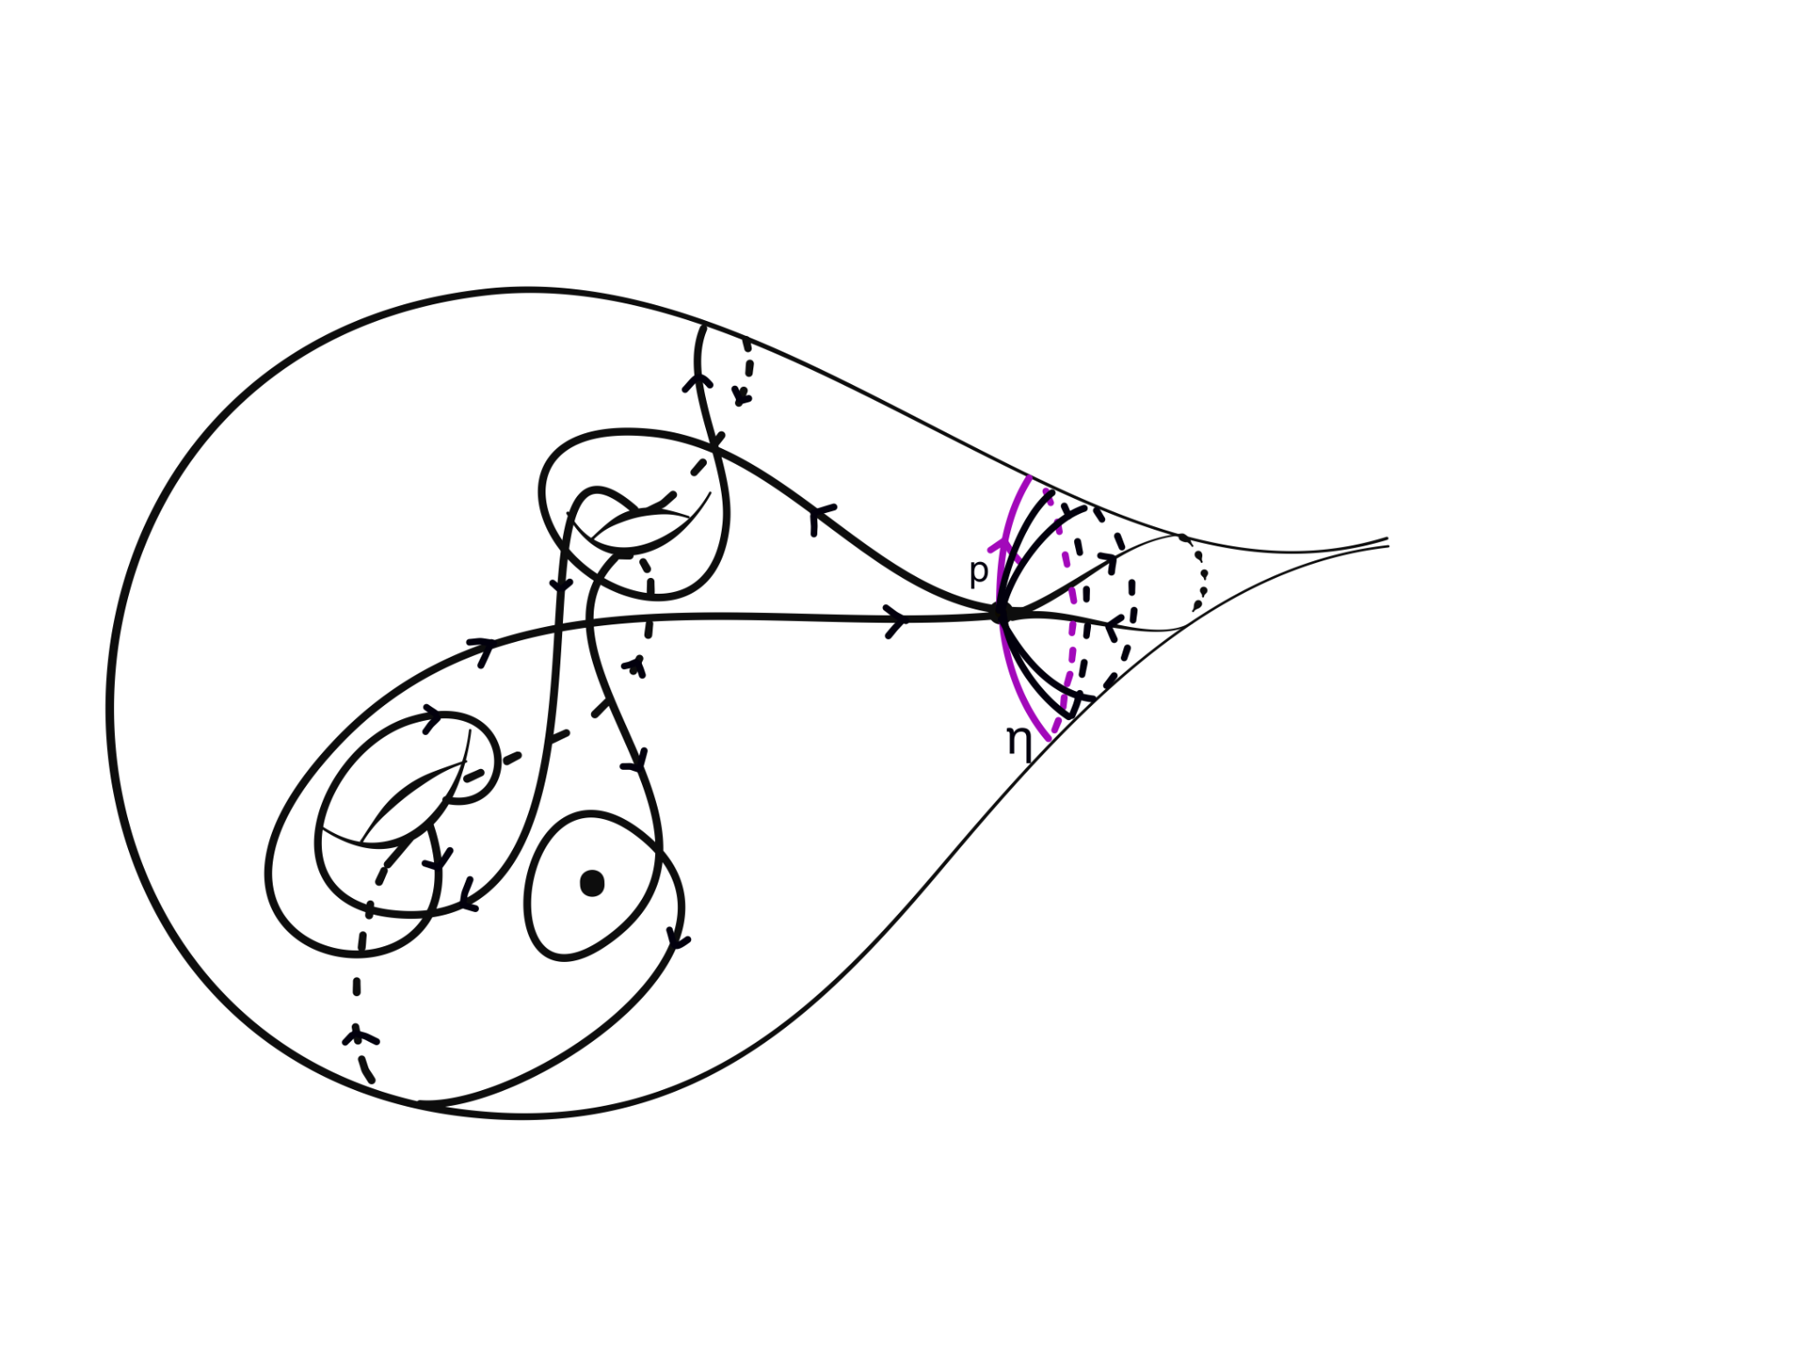
Family 2: Punctured Surface Case
Start with a (minimal) filling curve γ₀, with a subloop homotopic to a puncture.
Start at an intersection point of the subloop.
Given (m, n) , let γ be the curve η^{m} ∗ γ₀^{n} that start at p and goes around γ₀, n times, then around η, m times.
A (2,1) curve.

Slide 15
Question!
Are the curves in a family of different topological types?

Slide 16
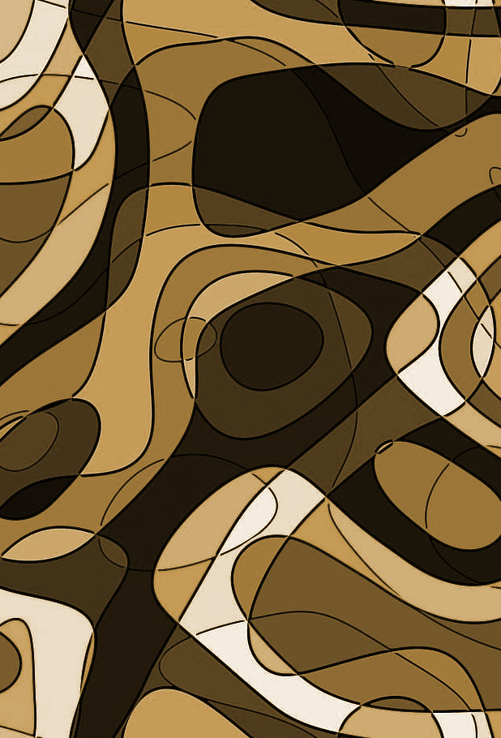
03
Invariants

Slide 17
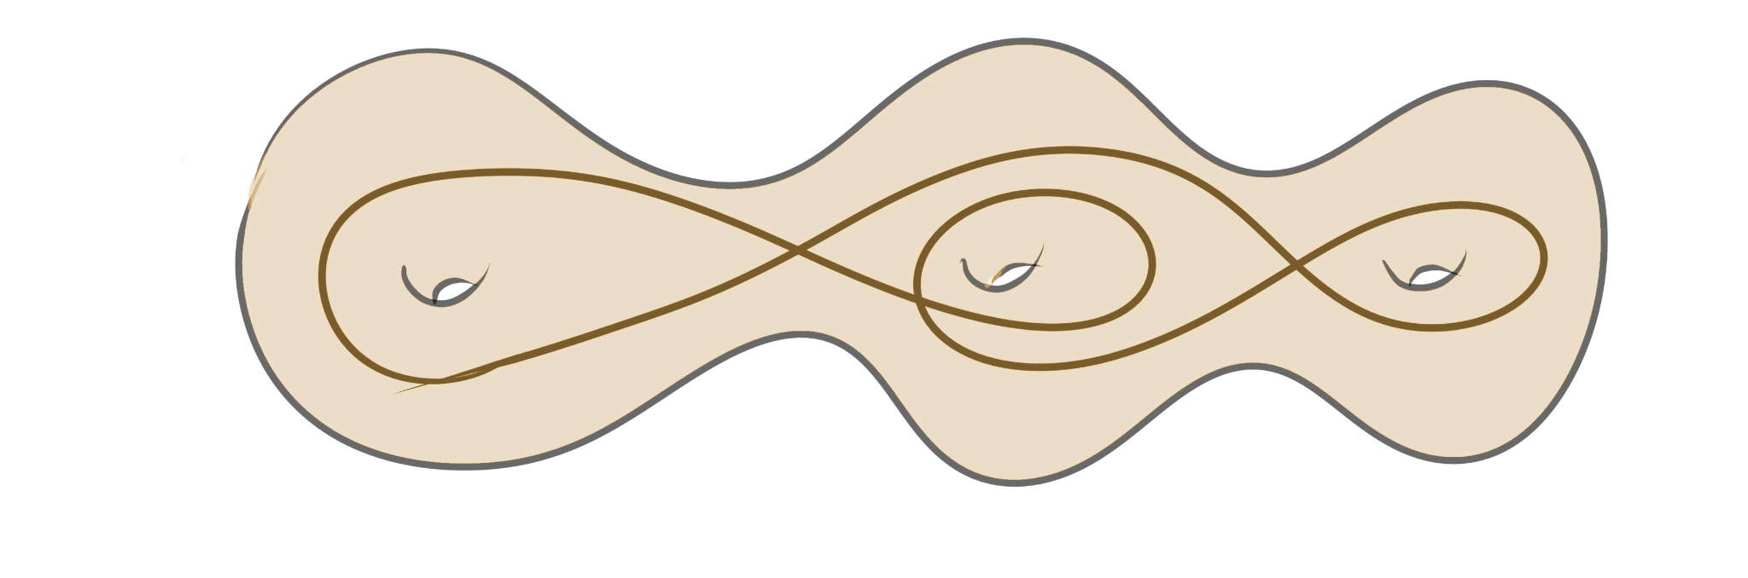
Self intersection number
If γ non-simple closed curve in 𝚺 , then the self intersection number of γ denoted by i(γ ,γ ) is the minimum number of self-intersection points of a curve in its free homotopy class in general position.
Example:
Self intersection number is invariant under action by a mapping class.
Curves with different self-intersections are of different topological types.

Slide 18
Computing intersection numbers:
Separating Curve Case:
i(γ, γ) = i(γ₀, γ₀)n² + (i(γ₀, η)n − 1)m
Punctured Surface Case:
i(γ, γ) = i(γ₀, γ₀)n² + m ± 1
Depends on n and m only!

Slide 19
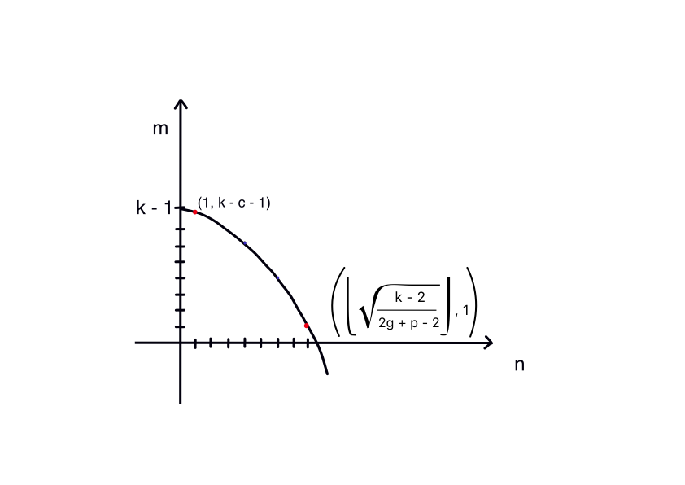
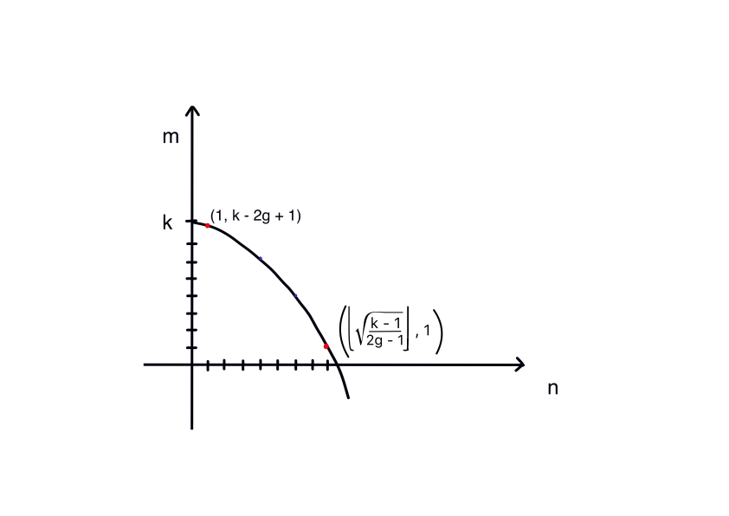
Admissible pairs
For a fixed k = i(γ, γ) where k >> 2g − 1, there are several choices of curves (pairs of integers(m,n)) in both curve family with k self-intersections. We call these admissible pairs.
Separating Curve Case
Punctured Surface Case
Generally there are more than one curve with same-intersection number

Slide 20
Question!
Are the curves with same self-intersection number of different topological types?

Slide 21
Inf invariant
Fix a topological surface 𝚺 and let Teich(𝚺) denote its Teichmüller space.
Consider a non-simple closed curve γ in 𝚺.
For (𝞍,X ) in Teich(𝚺) . Let lᵧ(X) denote the ‘X-length’ of the geodesic in the free homotopy class of 𝞍(γ).
We define the length infimum of γ as follows:
mᵧ = inf { lᵧ(X) : (𝞍, X ) in Teich(𝚺)}

Slide 22
Properties:
Invariant under action on Mapping Class Group on Teichmuller space.
The infimum is attained. (Mumford compactness theorem)
The infimum is unique. (Convexity of Weil-Petersson geodesics)

Slide 23
History:
This is a type of geodesic length function, first introduced by Fricke-Klein in 1897
(Vorlesungen über die Theorie der automorphen Functionen)
Geodesic Length Functions And The Nielsen Problem by Scott A. Wolpert in 1987

Slide 24
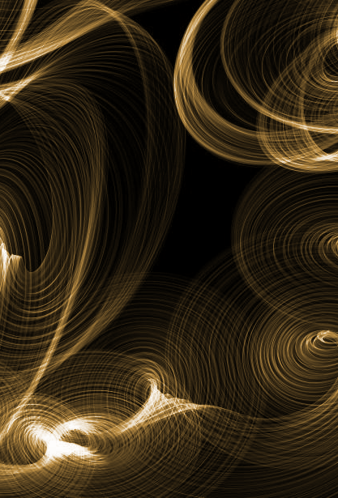
04
Relation between invariants

Slide 25

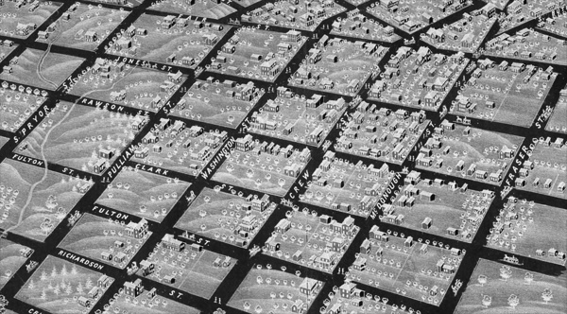
Motivation
Self intersection number vs Length
Want to buy : Self intersections
Currency: Length
Thin parts
Thick parts
We can get more intersection for less length in thin parts of the surface.
We can minimize length by making parts with more intersections thin.

Slide 26
Questions:
Relations between these invariants?
Is the inf invariant a complete invariant? Are there curves with same inf invariant?
Can the inf invariant distinguish curves that the self intersection number can’t?

Slide 27
Known Results
Length equivalent curves: Curves with same length for all hyperbolic metrics (C. Leininger, 2003)
Universal length bounds for non-simple closed geodesics on hyperbolic surfaces. (A. Basmajian, H.Parlier, and J.Souto., 2017)
Length bounds on shortest k-geodesics in different metric classes. (A. Basmajian, 2013)
Length minima for an infinite family of filling closed curves on a one-holed torus.(Z.Wang and Y.Zhang, 2022)
For geodesic current… (J. Sapir, S. Hensel, 2021, 2023)
Explicit inf length values for a certain of curves (uniform filling curves). (E. Girondo, G. González-Diez, R.A. Hidalgo, 2023)

Slide 28
05
Computing Invariants

Slide 29
Questions:
Relations between these invariants?
Is the inf invariant a complete invariant? Are there curves with same inf invariant?
Can the inf invariant distinguish curves that the self intersection number can’t?

Slide 30
Coarse length bounds
Separating Curve Case:
2n [d + r(ℓ_{η}(X)/2]+ mℓ_{η}(X) − C ≤ ℓ_{γ} (X) ≤ 2n [D + 2 r(ℓ_{η}(X)/2))+ Kℓ_{η}(X)] + mℓ_{η}(X)
Constants d, D, and K are independent of n and m, and only depend on γ₀
Punctured Surface Case:
nd + 2 log m − c₂ ≤ ℓ_{γ} (X) ≤ 2 log m + nℓ γ₀(X) + c₁
where c₁, c₂, d are positive constants that depend only on γ₀

Slide 31
Admissible pairs
For a fixed k = i(γ, γ) where k >> 2g − 1, there are several choices of curves (pairs of integers(m,n)) in both curve family with k self-intersections. We call these admissible pairs.
α_{k}
α_{k}
β_{k}
β_{k}
Separating Curve Case
Punctured Surface Case
Generally there are more than one curve with same-intersection number

Slide 32
Inf length bounds (Separating Curve Case)
mα_{k} ≤ 2D + 4 log (m / log m)+ K (log m /m) + log m, where m = (k − 2g + 1)
α_{k}
mβ_{k} ≥ 2d ⌊√(k − 1)/(2g − 1)⌋− C
β_{k}
mα_{k} ≲ log k < √k ≲ mβ_{k}
So we can distinguish at least two curves with same self intersection number

Slide 33
Inf length bounds (Punctured Surface Case)
mα_{k} ≤ 2 log(k − c − 1) + ℓγ₀ (X) + c₂
α_{k}
mβ_{k} ≥ d√(k − 2)/(2g + p − 2) − c₁
β_{k}
So, mα_{k} ≲ 2 log k < c√k ≲ mβ_{k}
So we can distinguish at least two curves with same self intersection number

Slide 34
06
Results

Slide 35
Theorem 1 (Separating Curve case)
Suppose χ(Σ) ≤ −2. There exists an infinite set of positive integer K and a collection of curve pairs {(α_{k}, β_{k})}, k∊K such that
(1) α_{k} and β_{k} are each filling curves
(2) i(α_{k}, α_{k}) = i(β_{k}, β_{k}) = k
(3) mα_{k} ≲ log k < √k ≲ mβ_{k}
(4) the optimal metrics {Xβ_{k}} are contained in a compact subspace of moduli space with bounded systoles.
(5) The metrics {Xα_{k}} limit to a stratum S in ∂M(Σ) which correspond corresponds to η being pinched.

Slide 36
Theorem 2 (Punctured Surface case)
Suppose Σ has negative Euler characteristic with genus g and n ≥ 1 punctures. There exists an infinite set of positive integer K and a collection of curve pairs {(α_{k}, β_{k})}, k∊K so that
(1) α_{k} and β_{k} are each filling curves
(2) i(α_{k}, α_{k}) = i(β_{k}, β_{k}) = k,
(3) mα_{k} ≠ mβ_{k}
(4) mα_{k} ≲ 2 log k < c√k ≲ mβ_{k}
(5) the metrics Xα_{k} and Xβ_{k} stay within a compact subspace of M(Σ) for all k.

Slide 37
Further Questions
What about the other curves with k self intersections? (In progress)
What is the shortest possible inf length for filling curves on a surface? (In progress)
Examples of filling curves with same self intersection number and same inf?
Understanding the inf length spectrum . . .

Slide 38
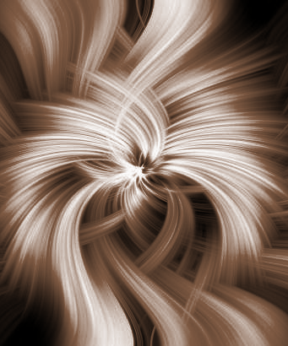
Thanks!
smondal@gradcenter.cuny.edu
Please keep this slide for attribution

